Slide 1
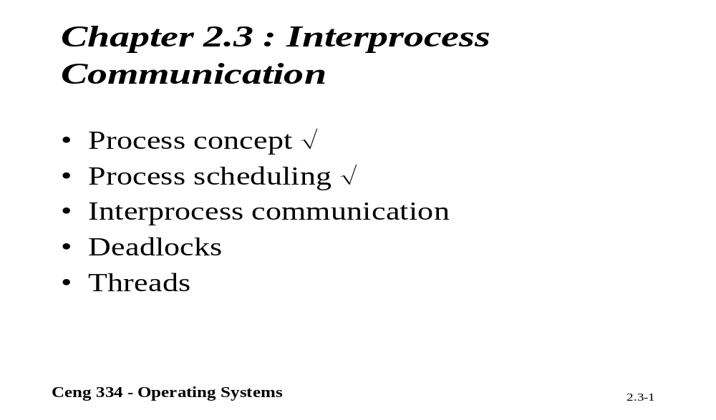
Chapter 2.3: Interprocess Communication

Slide 2
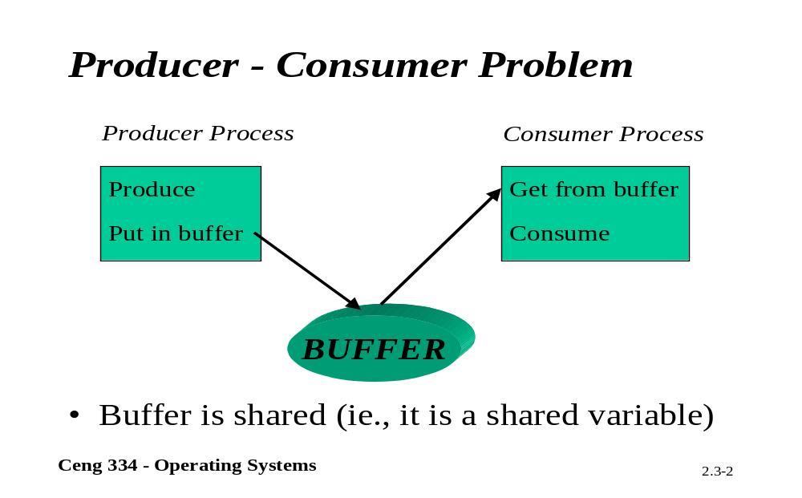
Producer Consomer Problem

Slide 3
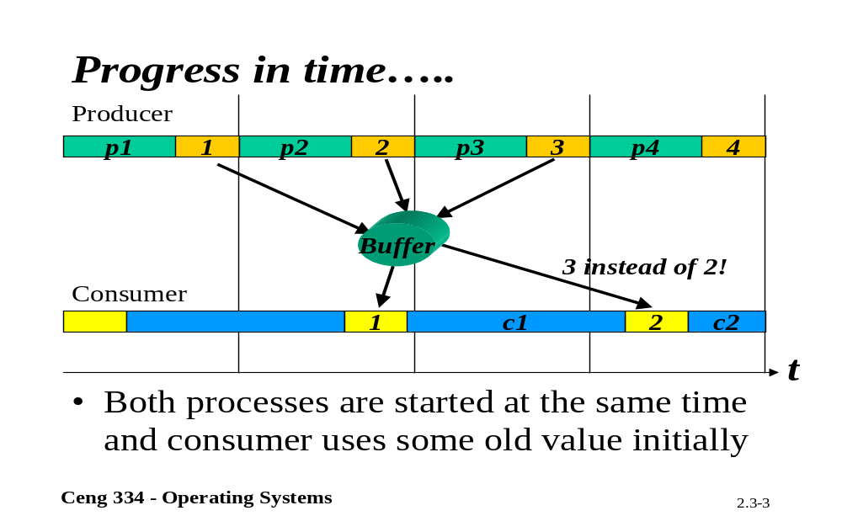
Progressing time

Slide 4
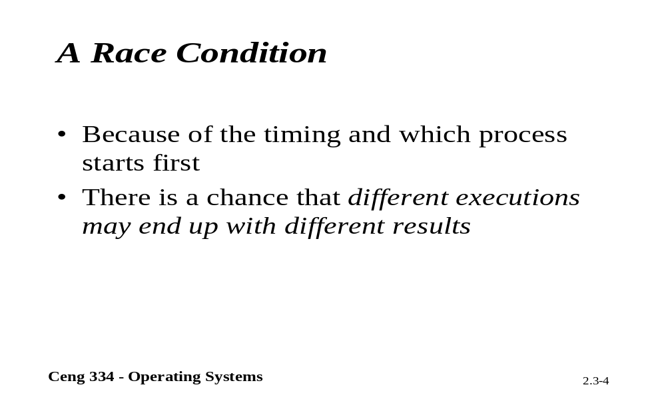
A Race Condition

Slide 5
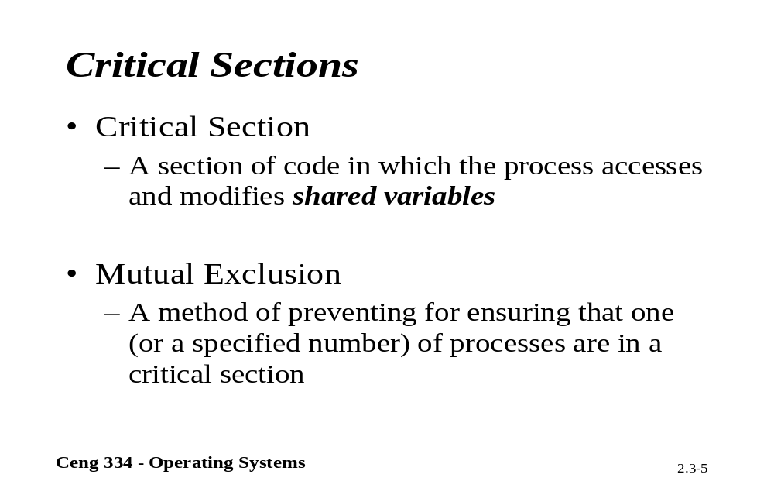
Critical Section

Slide 6
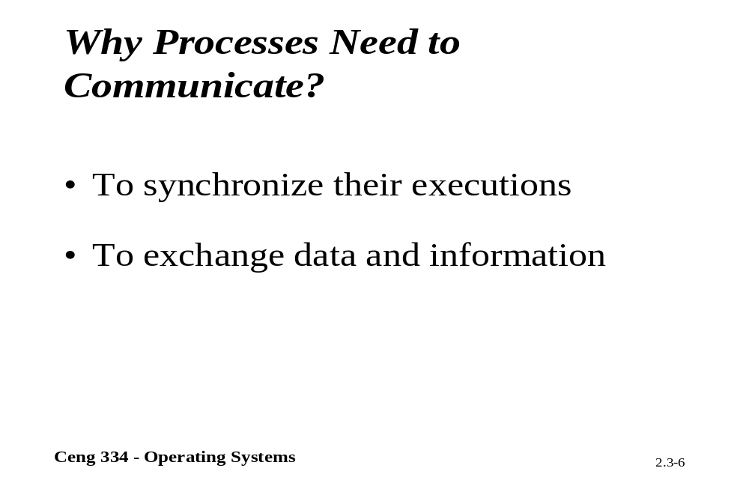
Why Interprocess Communication?

Slide 7
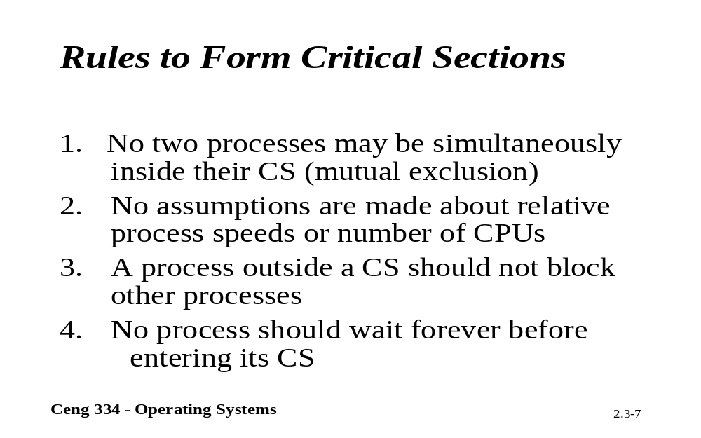
Rules to Interprocess Comm.

Slide 8
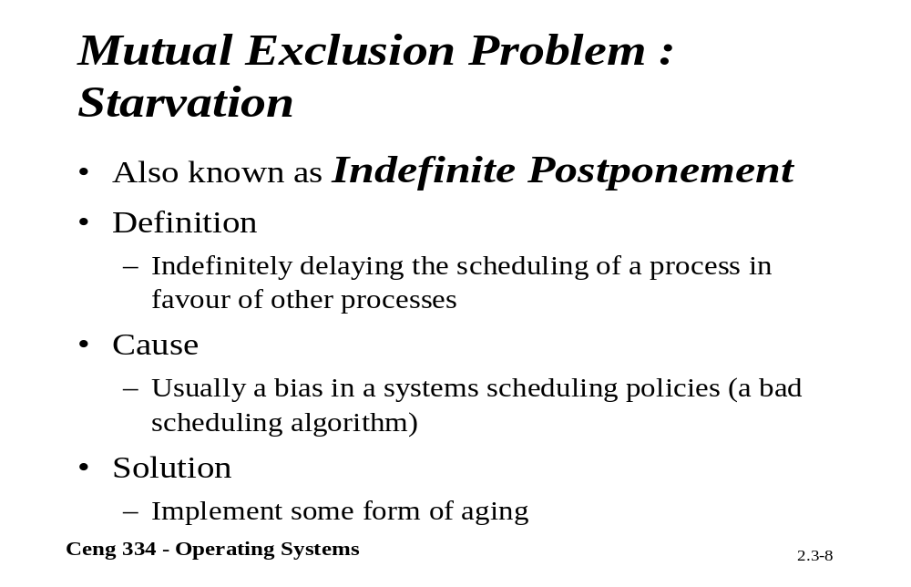
Starvation

Slide 9
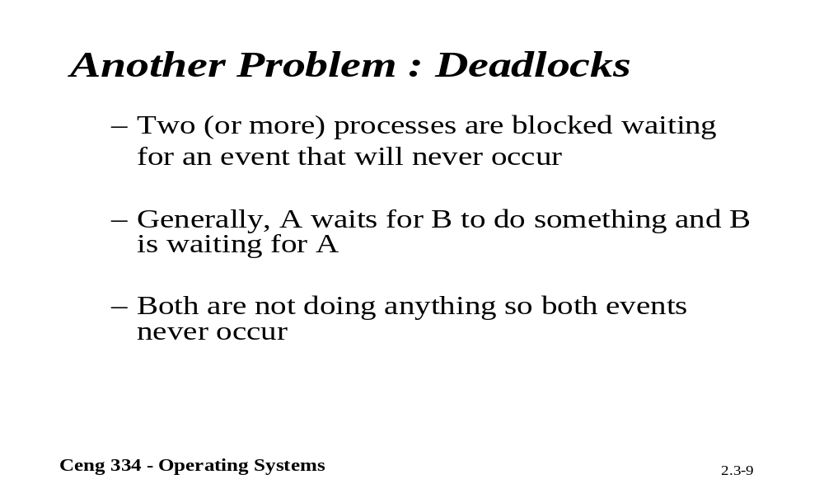
Deadlocks

Slide 10
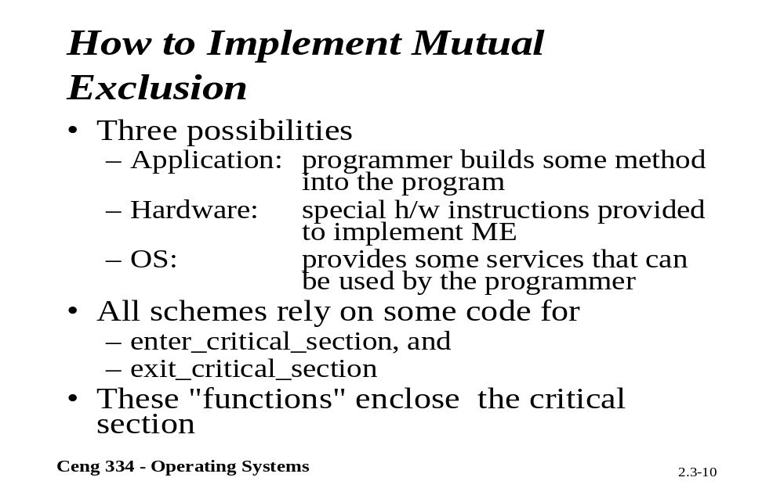
Implementig Mutual Exclusion

Slide 11
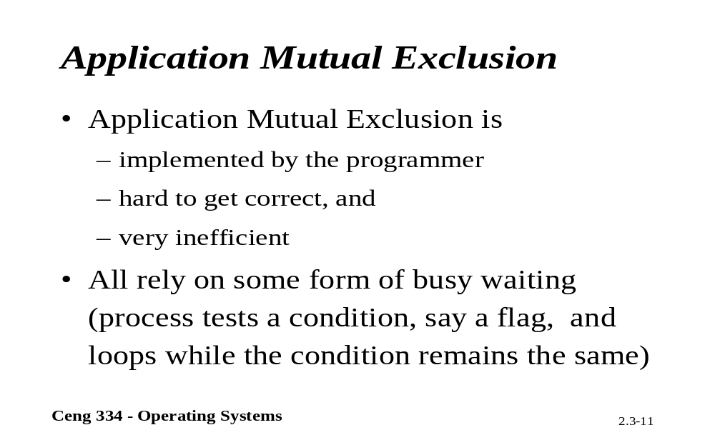
Application Mutual Exclusion

Slide 12
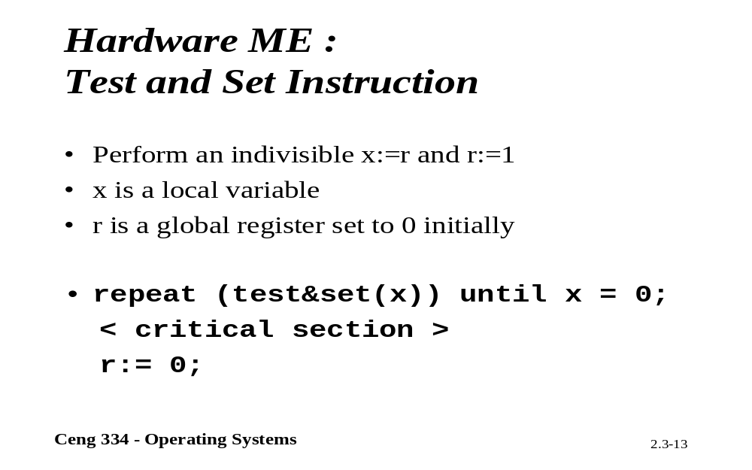
Test and Set

Slide 13
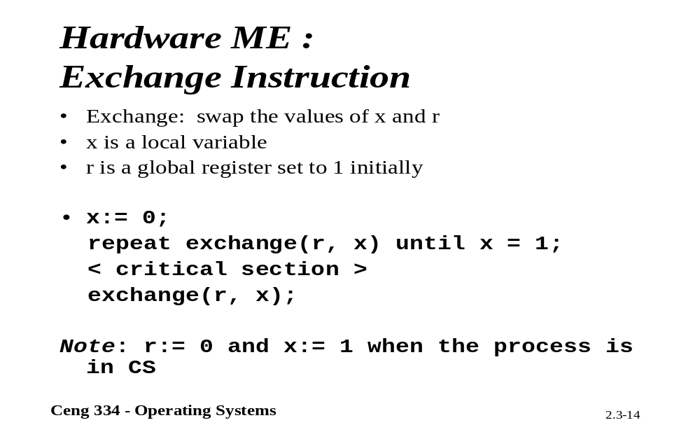
Harware Mutal Exculison

Slide 14
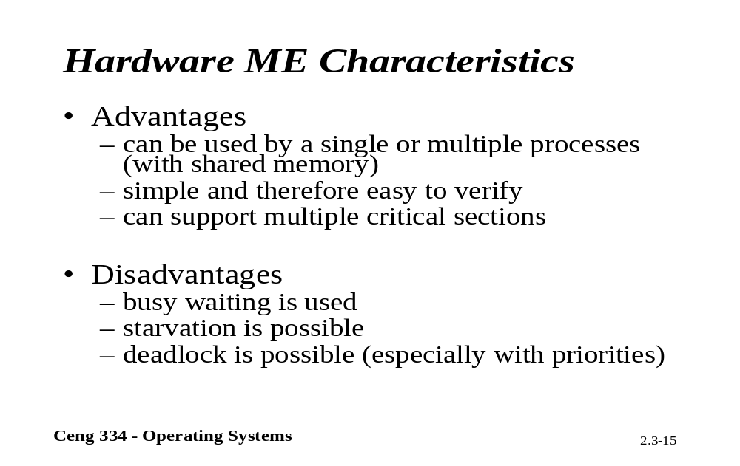
Characteristics

Slide 15
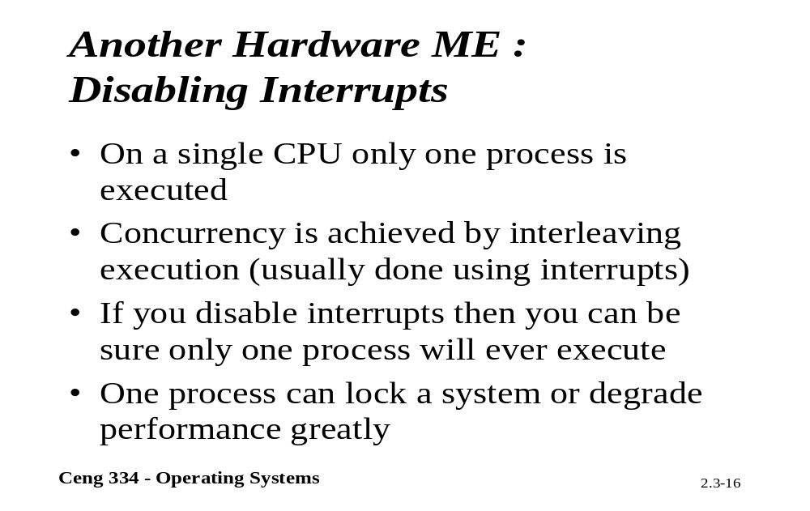
Disabling Interrups

Slide 16
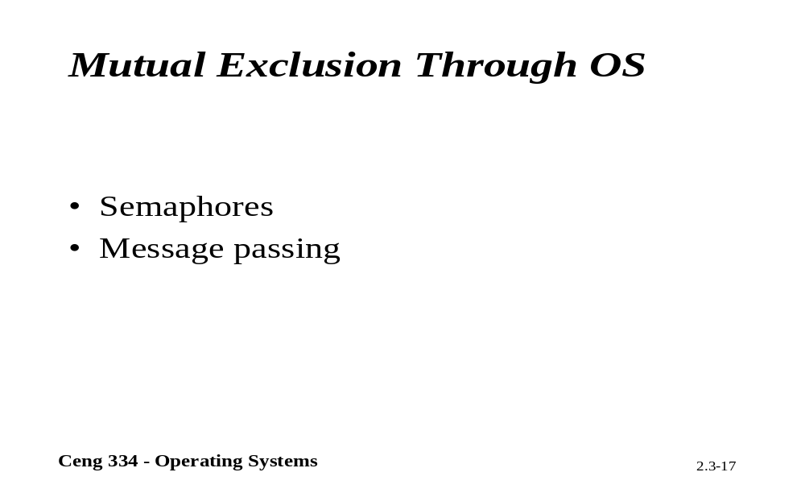
Mutual Exculusion Trough OS.

Slide 17
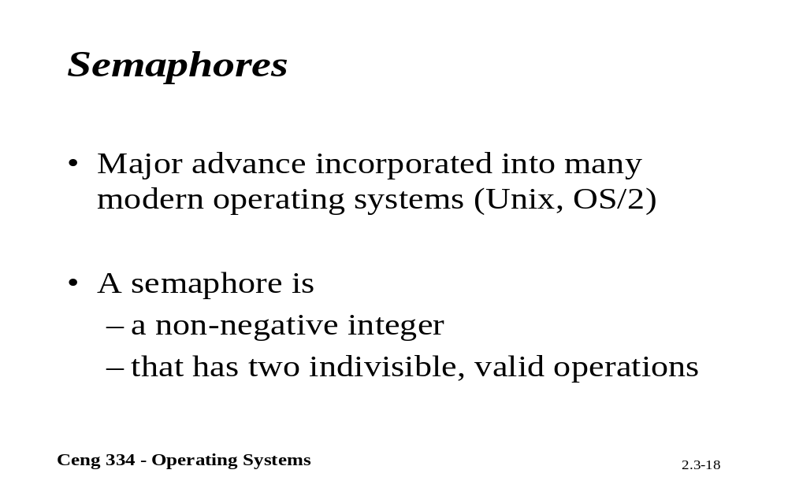
Semaphores

Slide 18
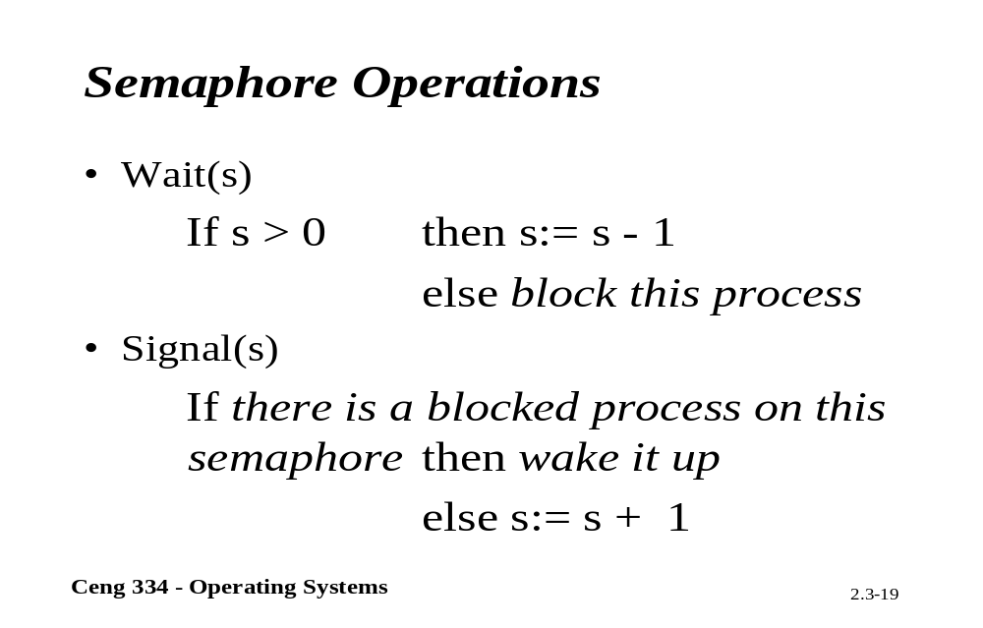
Semaphore Oparations

Slide 19
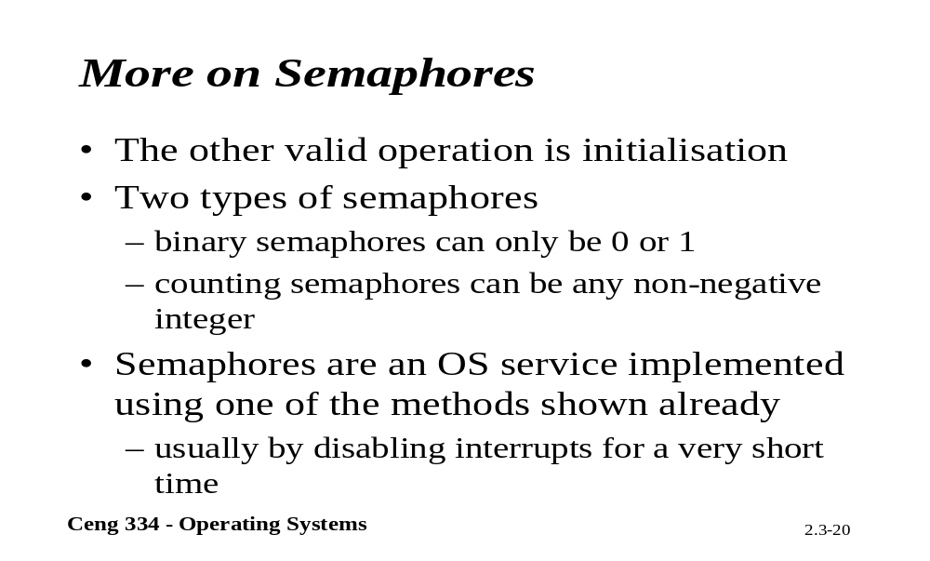
More on Semaphores

Slide 20
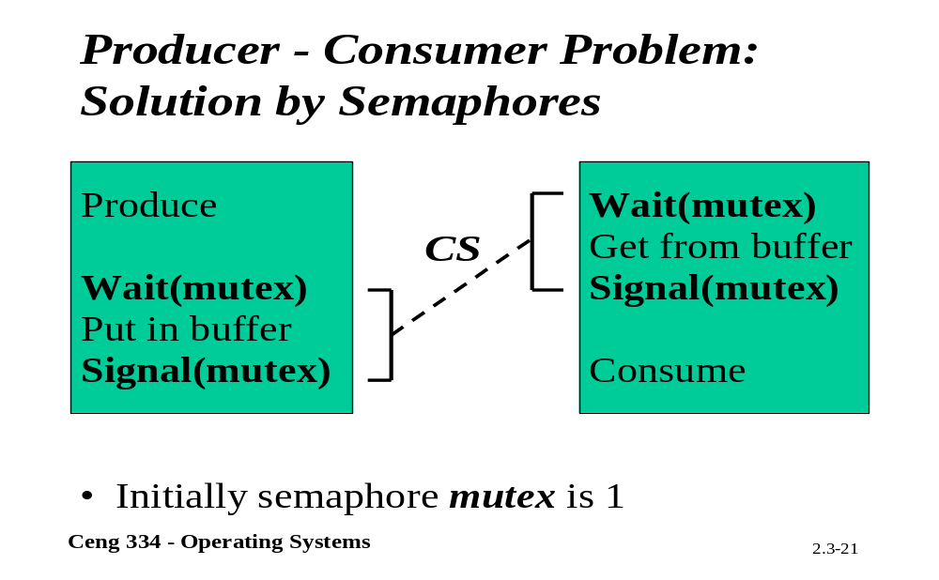
P-C Problem;Solution by Semephore

Slide 21
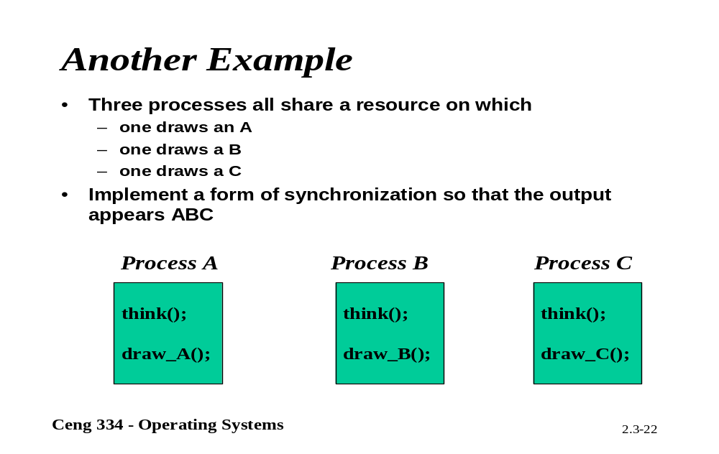
More Examples

Slide 22
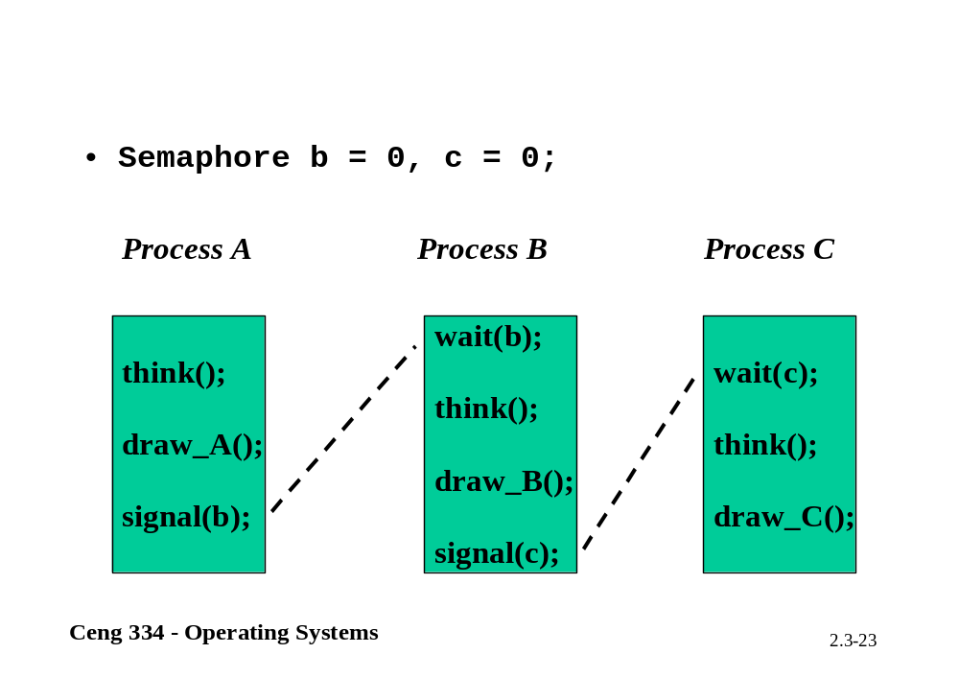

Slide 23
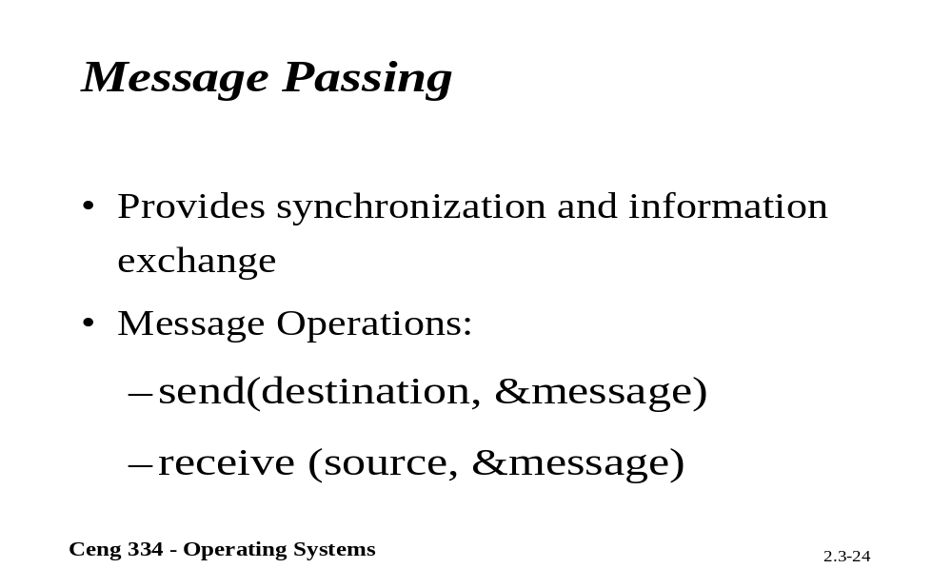
Message Passing

Slide 24
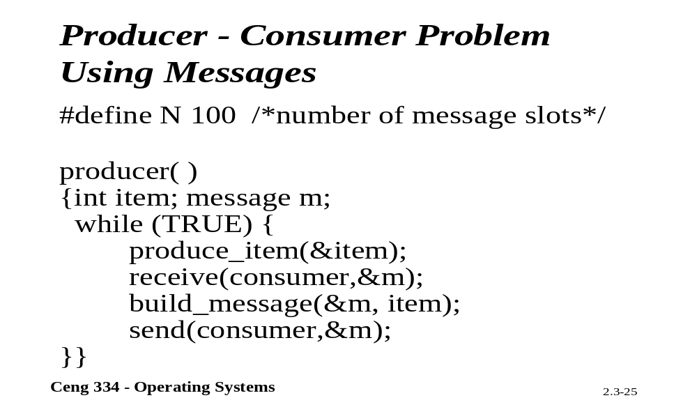
P-C Problem: Using Messages

Slide 25
